Slide 1
The childcare affordability crisis
A data-driven case for employer and policy action

Slide 2
Agenda
Introduction to Problem
Data Overview
Childcare impact on household income
Counties with higher childcare costs
States with higher childcare costs
Action Needed
Next Steps

Slide 3

Problem statement
In many U.S. counties, infant center-based care costs more per year than in-state college tuition yet receives a fraction of the policy attention.
Infant center-based care costs a median of $153.60/week nationally ($7,987 per year).
The U.S. Dept. of Health and Human Services defines affordable childcare as 7% or less of household income.
The national median burden is 16.1% (more than double the affordability threshold).
75% of U.S. counties exceed the HHS affordability threshold entirely.
For single mothers, infant care can consume 30 - 50% of take-home pay in high-cost states.

Slide 4
Data overview
14 Years of Data: 2008 through 2018, the longest national time-series for childcare prices ever published.
3,000+ Counties: county-level granularity across all 50 states enables local and regional comparisons.
227 Variables: weekly childcare prices by age group and care setting, paired with household income, poverty rates, and female labor force participation data from the American Community Survey.
Federal Source: published by the U.S. Dept. of Labor Women's Bureau; collected under OMB-approved protocols using state childcare market rate surveys.
Source: ICF. (2024). National Database of Childcare Prices. U.S. Dept. of Labor, Women's Bureau.

Slide 5
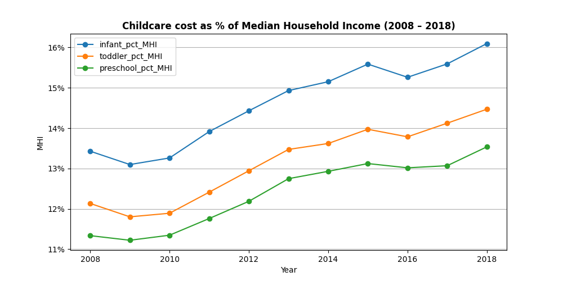
Childcare now consumes 14 – 16% of household income
+ 2.7 pp - Rise in infant care burden since 2008
16.1% - Median county infant care burden in 2018
2x - HHS 7% threshold was exceeded by all age groups

Slide 6
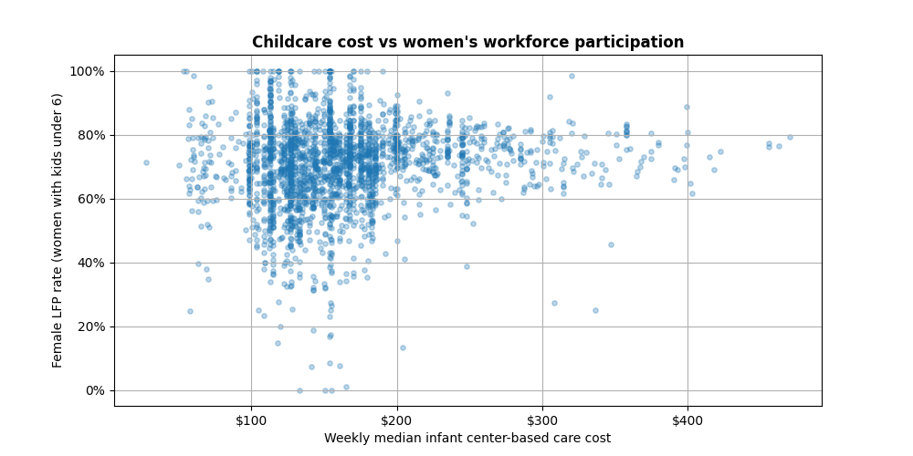
Counties with higher childcare costs show lower women’s workforce participation
The downward trend confirms as weekly infant care cost rises, female LFP rate among mothers with kids under 6 declines
Outliers above $300/week tend to show wider spread, suggesting that very high-cost markets affect families differently based on income level
The relationship is statistically meaningful even controlling for regional economic conditions

Slide 7
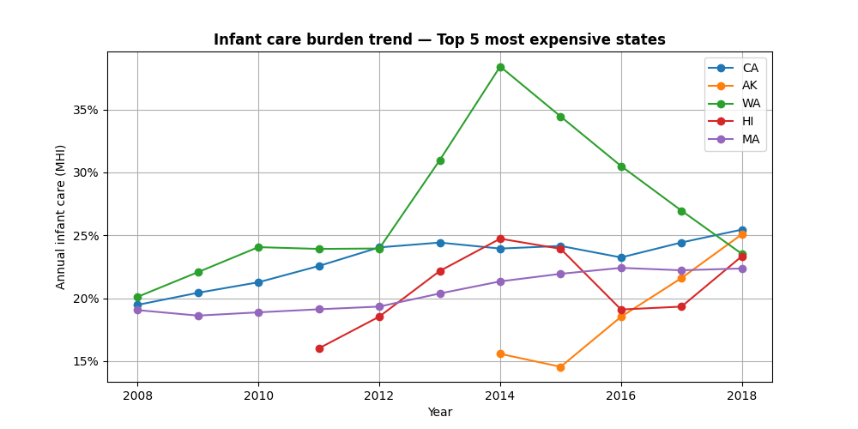
Washington state’s spike reveals how volatile the childcare burden can be
Washington (green) spiked to nearly 38% of MHI in 2014 - nearly triple the HHS affordability threshold of 7%.
Alaska's gap years (2015) reflect the NDCP's imputation limitations for sparse survey states.
No state in the top 5 most expensive has seen the burden fall. For families in these states, the question is not whether childcare is affordable - it is how much unaffordable they can sustain.

Slide 8
Action needed
For Employers: | For State Legislators: | For HR and Benefits Leaders:
Treat childcare subsidies as workforce infrastructure, not a discretionary perk Offer dependent care FSA matching or direct childcare benefits to retain working parents Companies that invest in childcare support see measurably higher female mid-career retention rates | Expand childcare subsidy eligibility and increase funding - particularly for infant care, the highest-cost tier States with stronger subsidy frameworks show lower affordability burdens and higher female workforce participation Targeted county-level investment will be more effective than uniform statewide approaches | Use the NDCP county-level data to benchmark childcare costs in your employees' home counties Partner with licensed providers to negotiate employer group rates for infant and toddler care Track female retention rates against childcare benefit utilization to measure return on investment

Slide 9
Next steps
Expand the NDCP analysis beyond 2018 as new data becomes available to track whether the post-pandemic affordability gap has widened or narrowed
Commission county-level impact studies pairing NDCP pricing data with employer turnover records to quantify the workforce cost of childcare unaffordability in specific labor markets
Advocate for federal legislation requiring employer childcare benefits reporting, like existing 401(k) and health insurance disclosure requirements, to create accountability and benchmarking
Replicate this analysis at the state level using the NDCP's geographic granularity to identify the specific counties within each state where subsidy investment would have the highest workforce impact

